Slide 1

Databricks Capstone Project
PREDICTING DEMAND TO PREVENT STOCKOUTS
Domain: E-Commerce & Retail
By Amrita Chakraborty

Slide 2
PROBLEM DEFINITION & BUSINESS CONTEXT
•DEMAND FLUCTUATES BY REGION, PRODUCT, AND TIME
•UNEXPECTED STOCKOUTS LEAD TO REVENUE AND CUSTOMER LOSS
GOAL: PREDICT DEMAND BEFORE IT OCCURS USING DATA & ML

Slide 3
WHY AI / ML INSTEAD OF RULES?
  Demand patterns are non-linear and seasonal
  Manual rules fail at scale
  ML can learn hidden patterns from historical data

Slide 4
ABOUT THE DATASET
CONTEXT
This dataset is designed to represent typical transactional data from an e-commerce business environment. It reflects how online retail platforms record daily orders, track product performance, and monitor financial outcomes across different regions and time periods. Such datasets are commonly used in business analytics to understand customer purchasing behavior, evaluate sales strategies, and support data-driven decision making. The dataset is suitable for beginners as well as intermediate users who want to practice data cleaning, visualization, exploratory data analysis, and basic predictive modeling in a realistic retail setting
CONTENT
The dataset contains 3,500 records of individual e-commerce orders with seven main attributes: Order Date, Product Name, Category, Region, Quantity, Sales, and Profit. Each row corresponds to a single transaction, providing both descriptive information (product, category, and region) and numerical business metrics (quantity sold, total sales revenue, and profit). The order dates range from 2022 to 2024, making the dataset useful for time-based analysis such as monthly or yearly sales trends. This structured tabular data can be used to analyze product performance, compare regional sales, study the relationship between sales and profit, and build simple forecasting or classification models.
SOURCE URL:https://www.kaggle.com/datasets/zahranusratt/e-commerce-orders-and-sales-performance-datasett

Slide 5
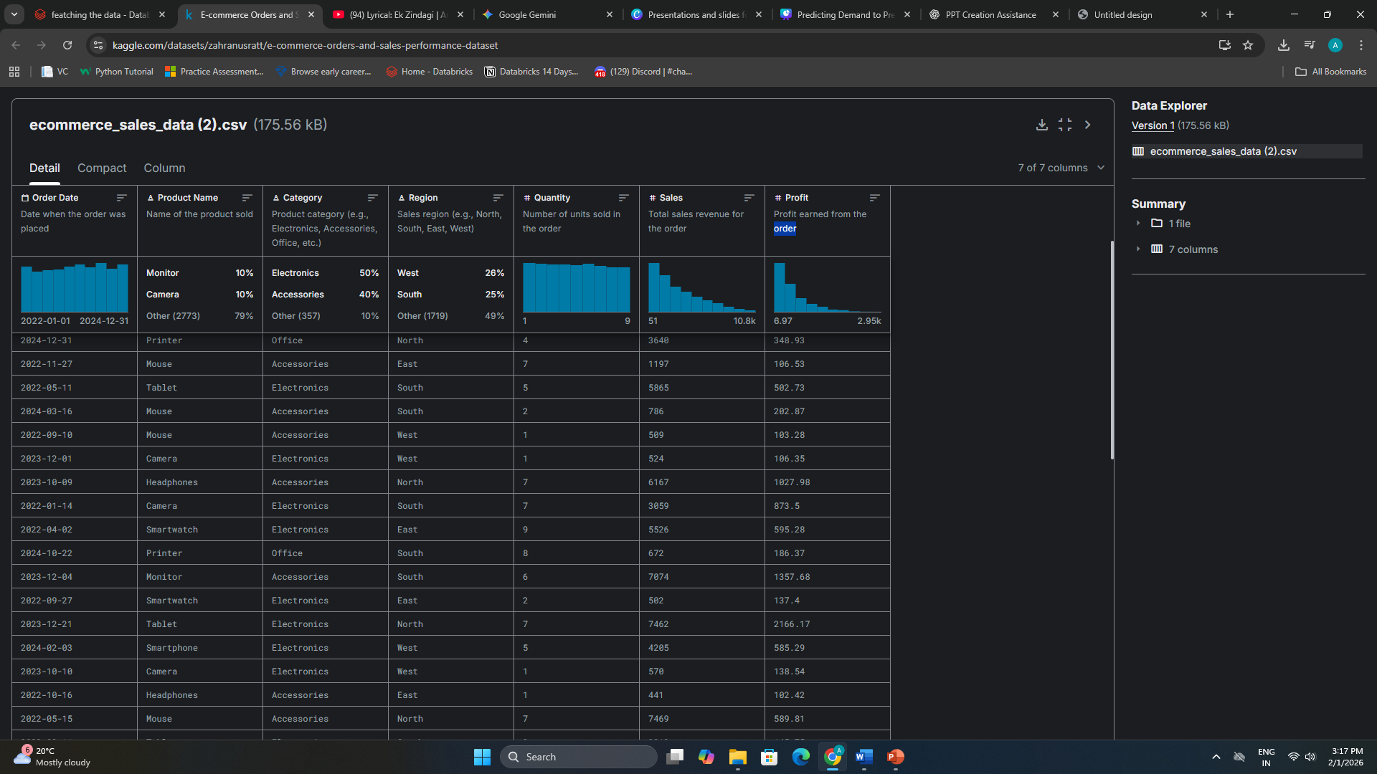

Slide 6

END-TO-END DATA ARCHITECTURE & PIPELINE
Medallion Architecture
  Bronze layer for raw data ingestion
  Silver layer for cleaned and validated data
  Gold layer for aggregated and ML-ready datasets
Databricks Jobs Pipeline
  Each layer executed as a separate task
  Tasks orchestrated using Databricks Jobs
  Automated and repeatable data processing flow

Slide 7
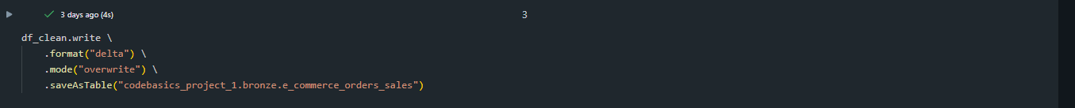
DELTA LAKE IMPLEMENTATION
DELTA TABLES WITH ACID TRANSACTIONS
ACID Transactions ensure reliable data operations in Delta Lake.
They guarantee that data writes are atomic, consistent, isolated, and durable,
preventing partial writes and ensuring data accuracy even during concurrent operations.

Slide 8
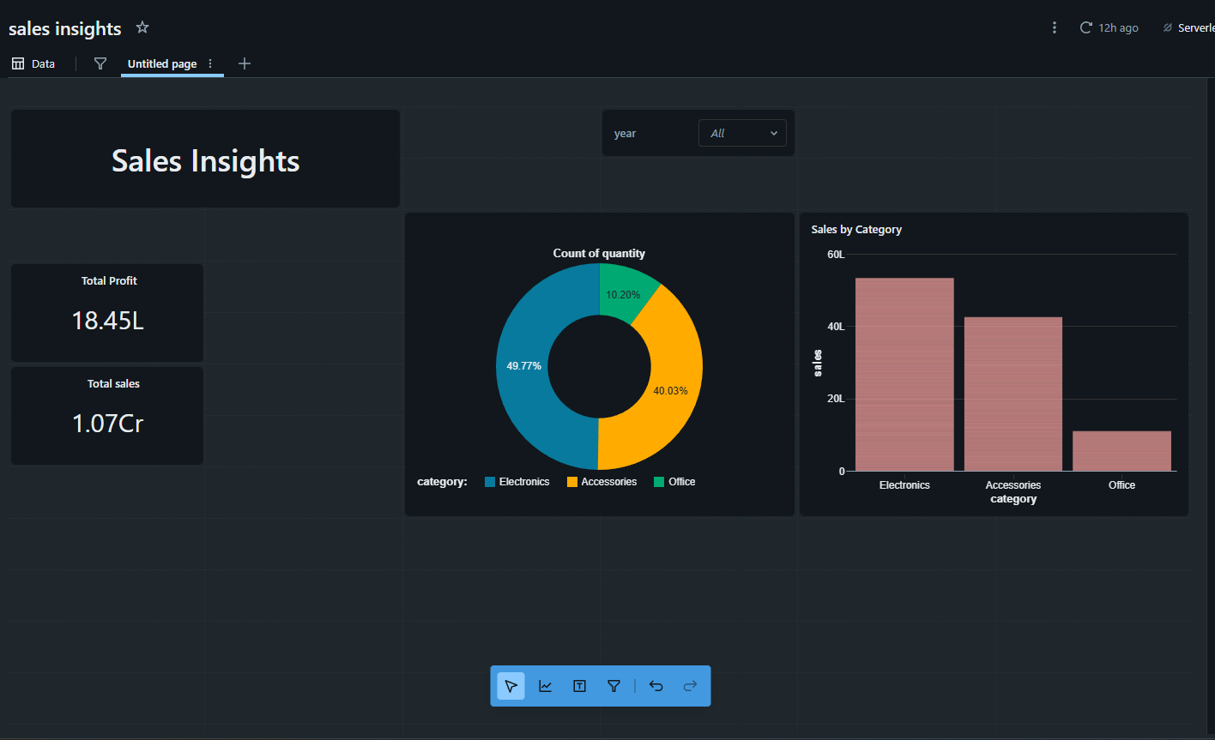
DATA ANALYSIS

Slide 9
DATA UNDERSTANDING & FEATURE ENGINEERING
  Selected region, product, category, and time as key features
  Defined demand quantity as the target variable
  Handled missing and noisy data through validation and cleaning
  Aggregated and transformed raw data into ML-ready datasets

Slide 10
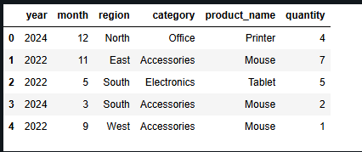
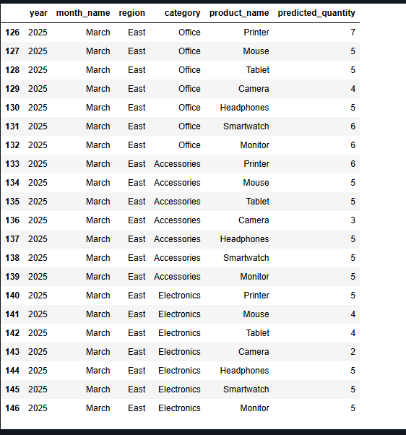
ML DATA PREPARATION & TRAIN–TEST SETUP
Feature Selection
  Selected region, product category, and time as input features
  Defined demand quantity as the target variable
Training & Testing Setup
  Model trained on historical demand data
  Tested on upcoming / future time periods to validate predictions

Slide 11
MODEL SELECTION & TECHNICAL REASONING
Model Used : Random Forest Regressor
Why This Model
  Suitable for supervised regression tasks
  Handles non-linear relationships in demand data
  Works well with structured tabular datasets
  Reduces overfitting compared to a single decision tree
Why a Baseline Model
  Establishes a reliable performance baseline
  Easy to train and evaluate in a limited time setup
  Balances performance and interpretability
Limitations
  Does not explicitly model time-series seasonality
  Requires feature engineering for temporal patterns
  Model interpretability is limited compared to linear models

Slide 12
BUSINESS IMPACT & PRACTICAL USE
Business Impact
  Enables early identification of high-demand products
  Helps reduce stockouts across regions and time periods
  Supports better inventory planning using data-driven forecasts
Practical Use
  Forecast demand for upcoming months or regions
  Align inventory levels with predicted demand
  Improve customer satisfaction by ensuring product availability

Slide 13
THANK YOU

